Slide 1


Data-Driven Personalized Workout Optimization System
Venkatesh Nagarjuna, Diluni Peiris, Manoj Kodihalli Venkatesh, Jose Luis Garcia Montero, Ella Brown

Slide 2
Introduction
Rising Obesity Rates in the U.S.:
Severe obesity in adults increased from 4.7% (1999–2000) to 9.2% (2017–2020).
Among children/adolescents, rates rose from 7.7% to 9.7%.
Importance of Physical Activity:
Essential for maintaining healthy weight and cardiovascular health.
Reduces risk of obesity-related conditions (e.g., diabetes, hypertension).
Regular movement is critical, from structured workouts to everyday activities.
Project Objectives:
Analyze 10,000+ fitness records covering workouts, health metrics, and lifestyle factors.
Predict workout efficiency based on user-specific activity data.
Create personalized fitness plans tailored to individual physical traits, fitness goals, and mood enhancement.

Slide 3
40.3 %
prevalence of obesity
31.6 %
260M
U.S. adults considered obese
lower in adults with a bachelor’s or more
estimated to be obese in U.S. by 2050
Some Statistics on Obesity

Slide 4
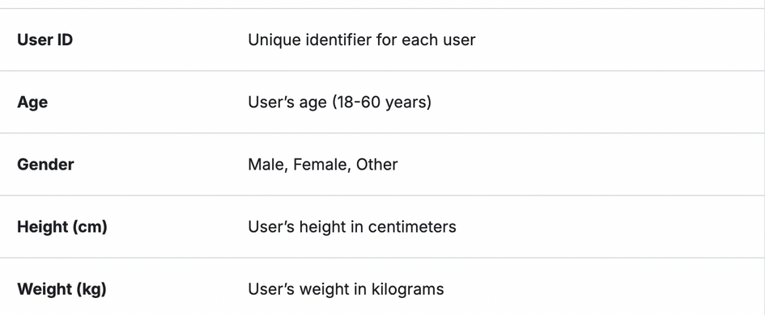
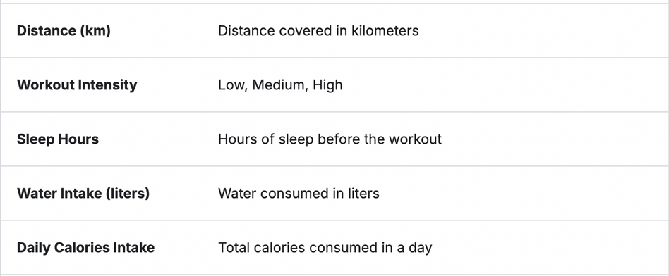
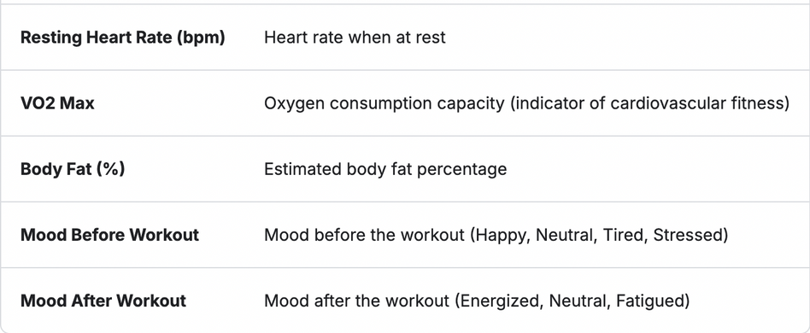
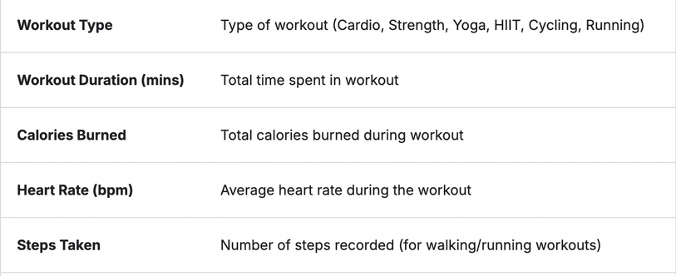
Our Dataset
This dataset from Kaggle contains 10,000+ records of workout and fitness-related data collected from various fitness apps and devices. It is designed to help analyze and predict workout efficiency based on user activity, health metrics, and lifestyle factors.
Dataset link

Slide 5
Why this dataset?
With obesity and severe obesity on the rise, it’s crucial to implement effective exercise programs that encourage healthier lifestyles
Alarming statistics can discourage people from starting; exercise programs should focus on accessibility, not just weight loss
By using data from fitness apps and devices it allows us to examine what people in real life are doing and tailor workouts based on individual fitness levels, goals, physical health, and habits
What makes it relevant to this important issue?

Slide 6
Proposed SMART questions
What combination of workout types and durations maximizes calorie burn efficiency for different user profiles (clustered by age, BMI, and fitness level)?
How does the relationship between heart rate patterns and calorie burn vary across different workout types, and can this predict optimal workout intensity?
Can we identify distinct user profiles based on their workout patterns using clustering analysis on workout duration, calorie burn, and heart rate?
Is there an effect on calorie burn based on your workout type and BMI Category?
Is there a link between poor sleep and resting heart rate?
Is there a relationship between mood before and mood after workout?

Slide 7

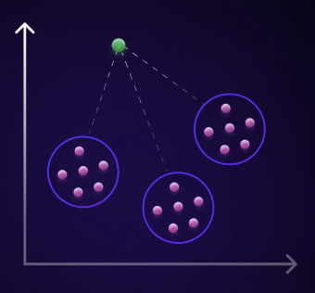
Coding
Data Preparation
Removing Redundant Columns
Renaming Columns
Updating Data Types
Missing data Imputation
Handling Outliers
Feature Creation [BMI Category, Age Groups]
EDA
SMART Questions

Slide 8
Demographic Analysis
This section examines the demographic attributes of individuals in the dataset, including age, gender, and BMI. Understanding these demographics is crucial for tailoring fitness programs and identifying trends among different groups.​
Performance Metrics
Here, we analyze key performance indicators such as workout duration, calories burned, and heart rate. These metrics provide insights into the effectiveness of various workouts and overall fitness levels.​
Workout Patterns
EDA
This analysis explores the types of workouts performed, frequency, and timing. Identifying common patterns helps in understanding user preferences and designing more effective fitness programs.​ By delving into these sections, we can uncover valuable insights to enhance fitness routines and promote healthier lifestyles.
Exploratory Data Analysis

Slide 9
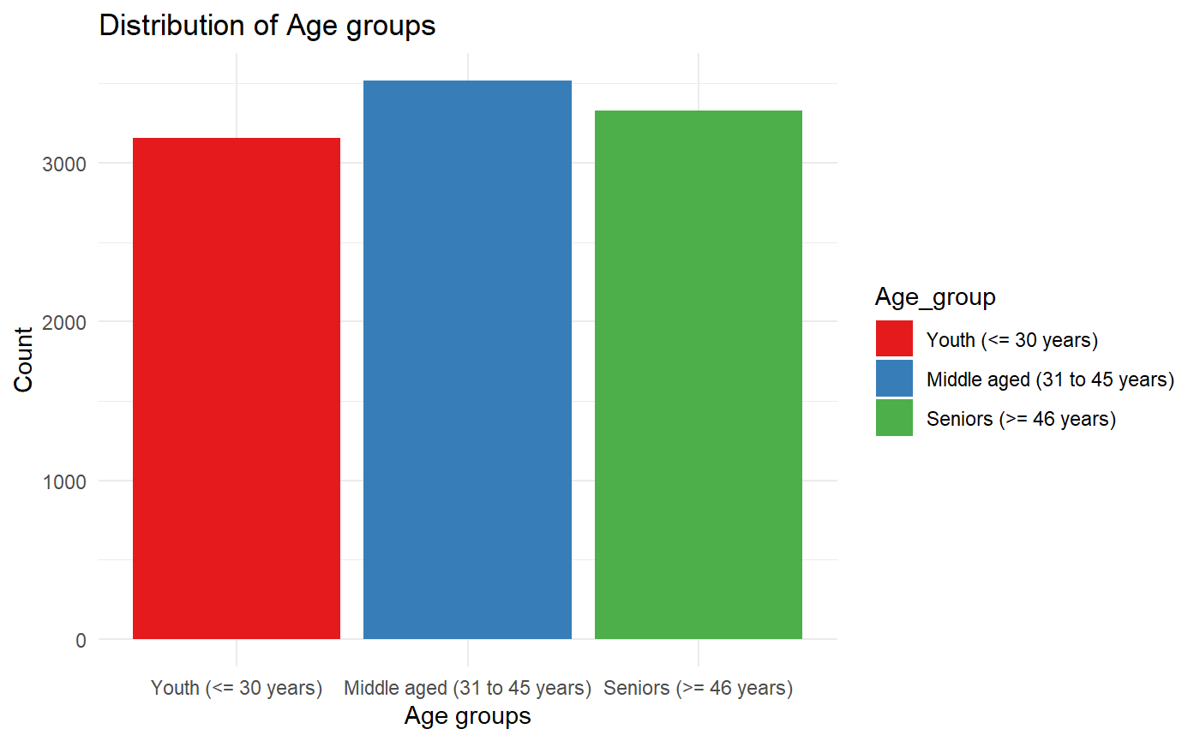
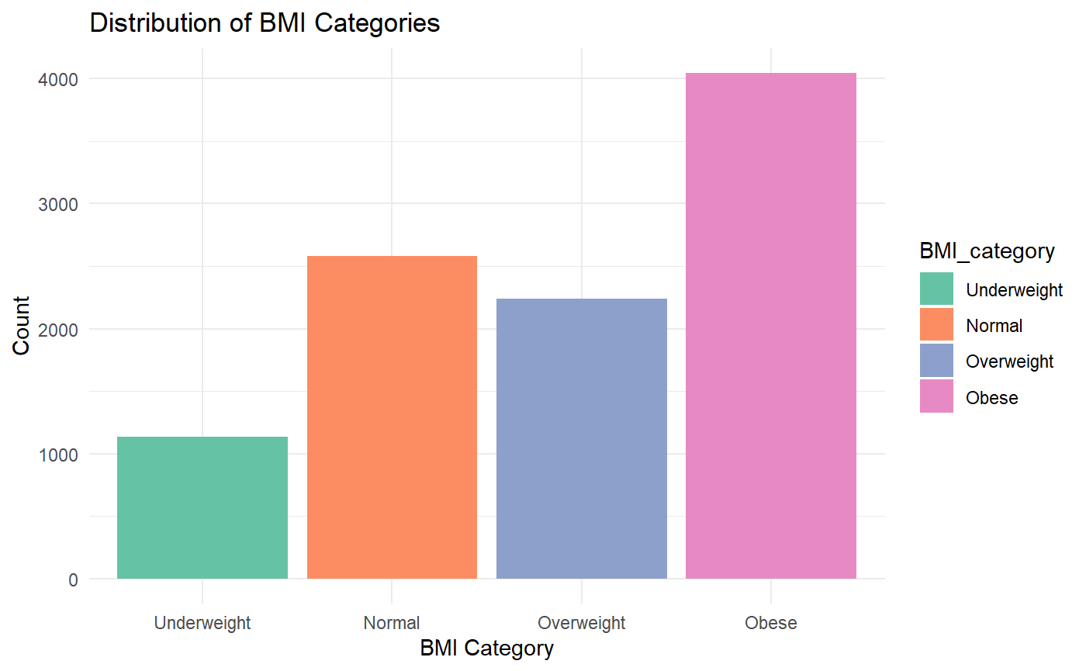
Demographic Analysis
Setbacks

Slide 10
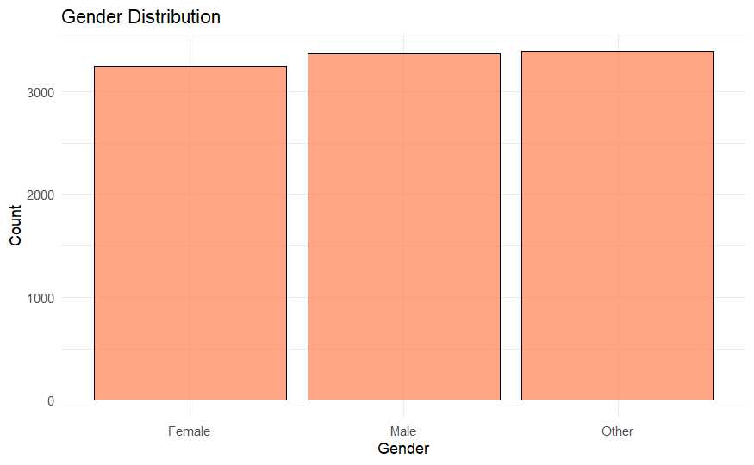
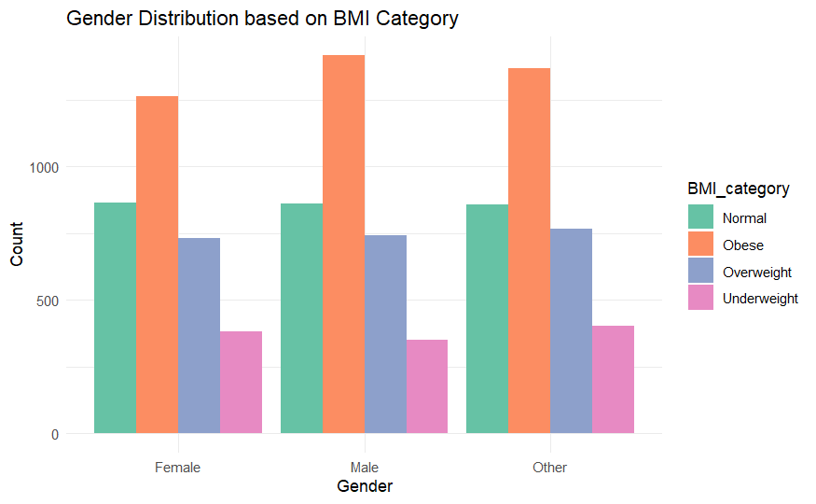
Demographic Analysis
Setbacks

Slide 11
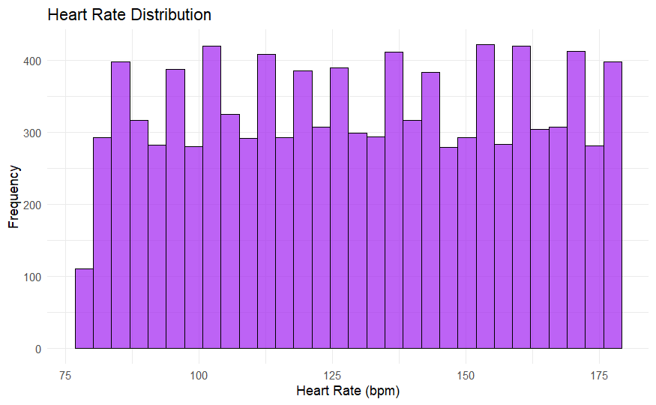
Performance Metrics
Workout_Duration_mins, Calories_Burned, Heart_Rate_bpm
Setbacks

Slide 12
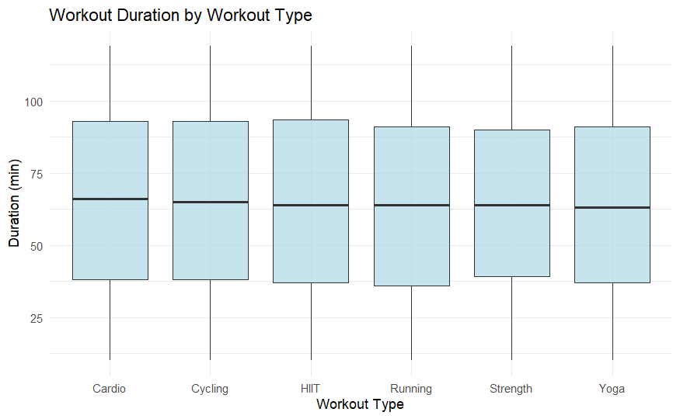
Workout Patterns
Workout_Duration_mins, Calories_Burned, Heart_Rate_bpm
Setbacks

Slide 13
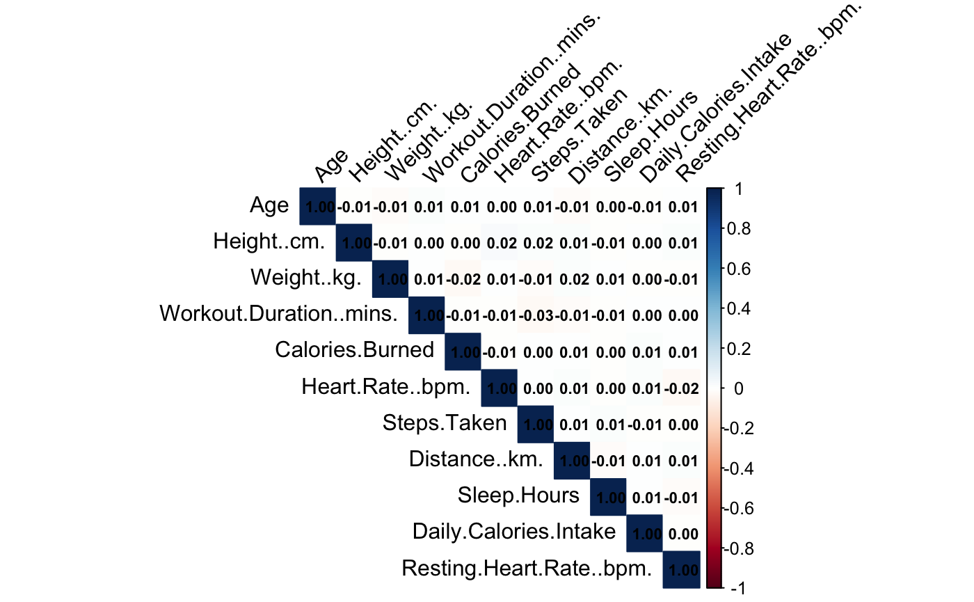
No Significant Correlation between variables
Setbacks

Slide 14
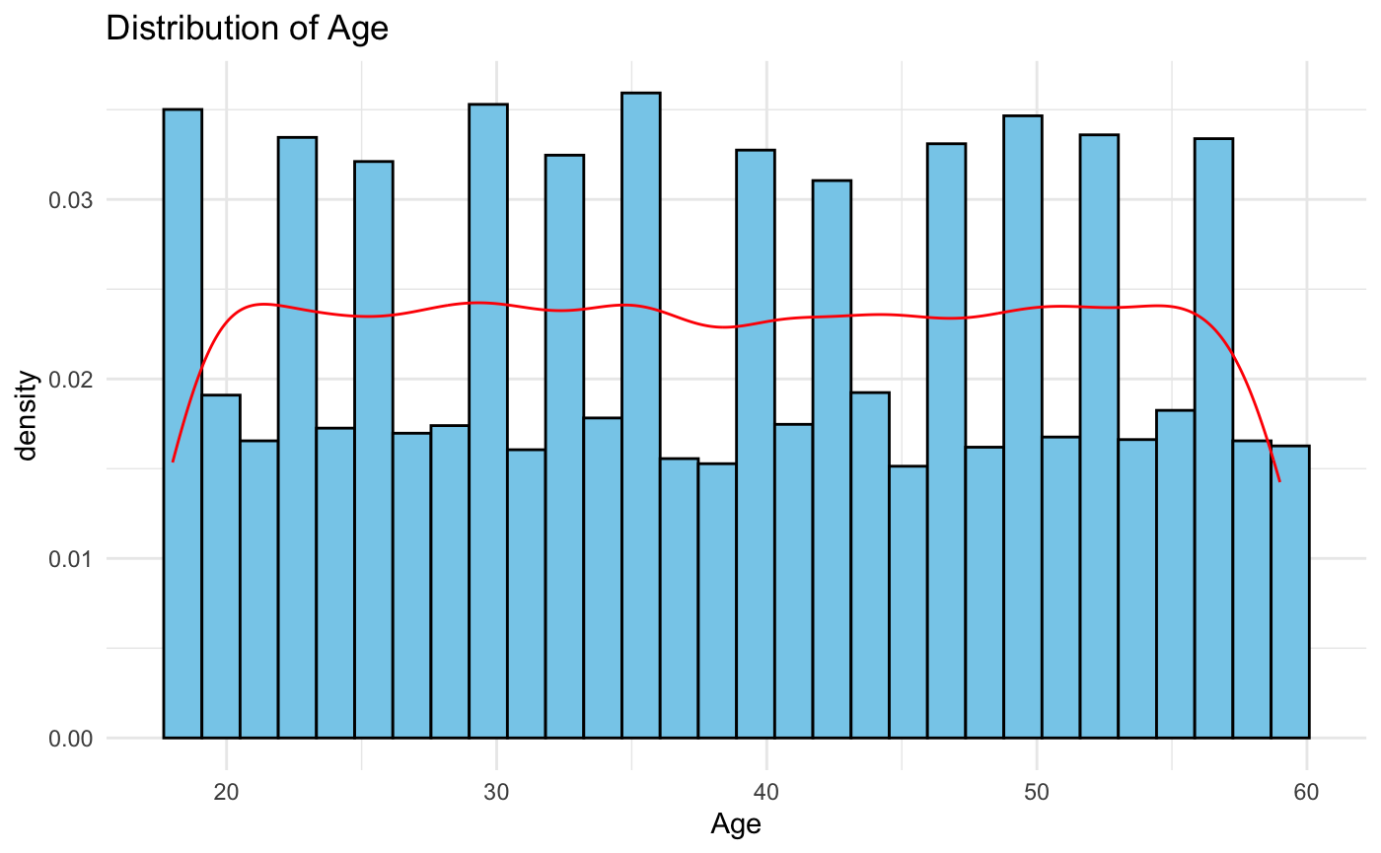
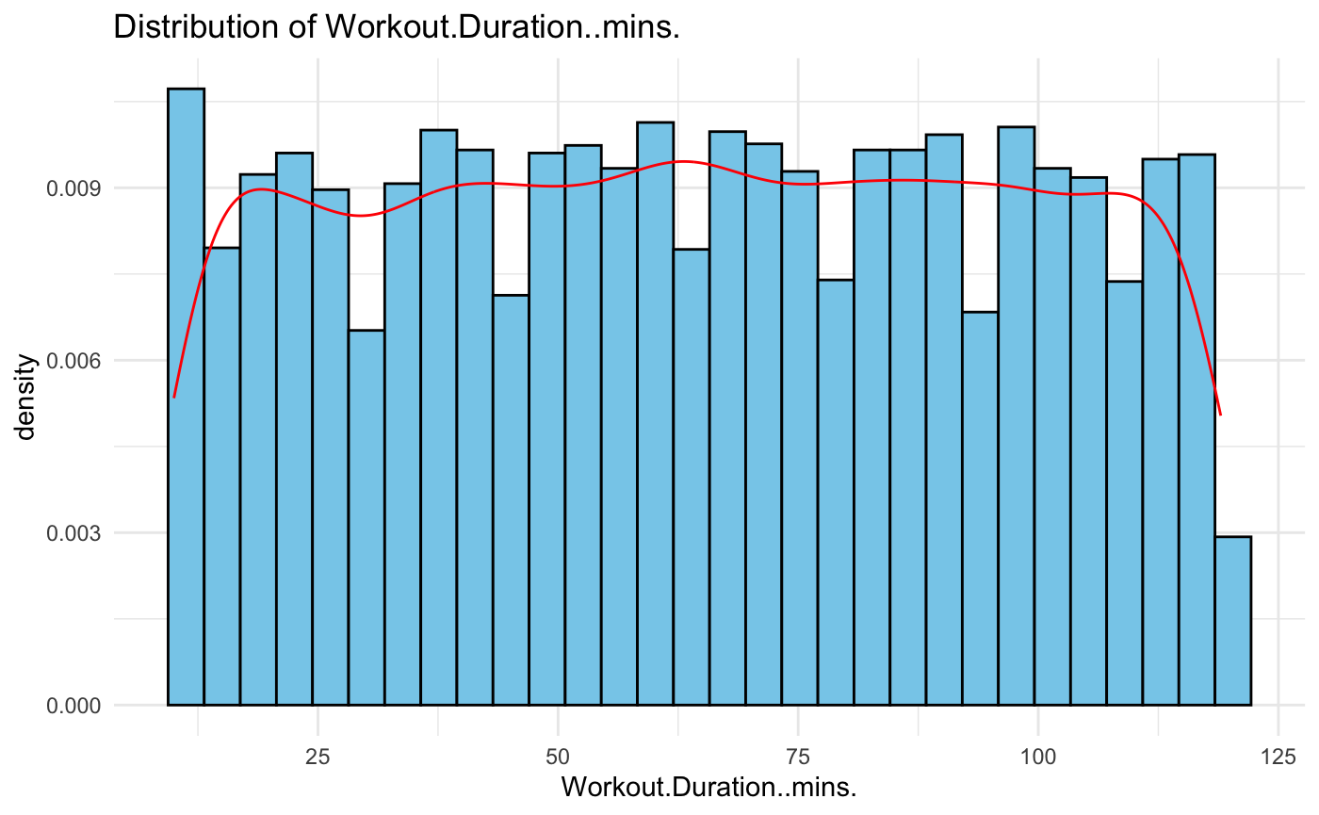
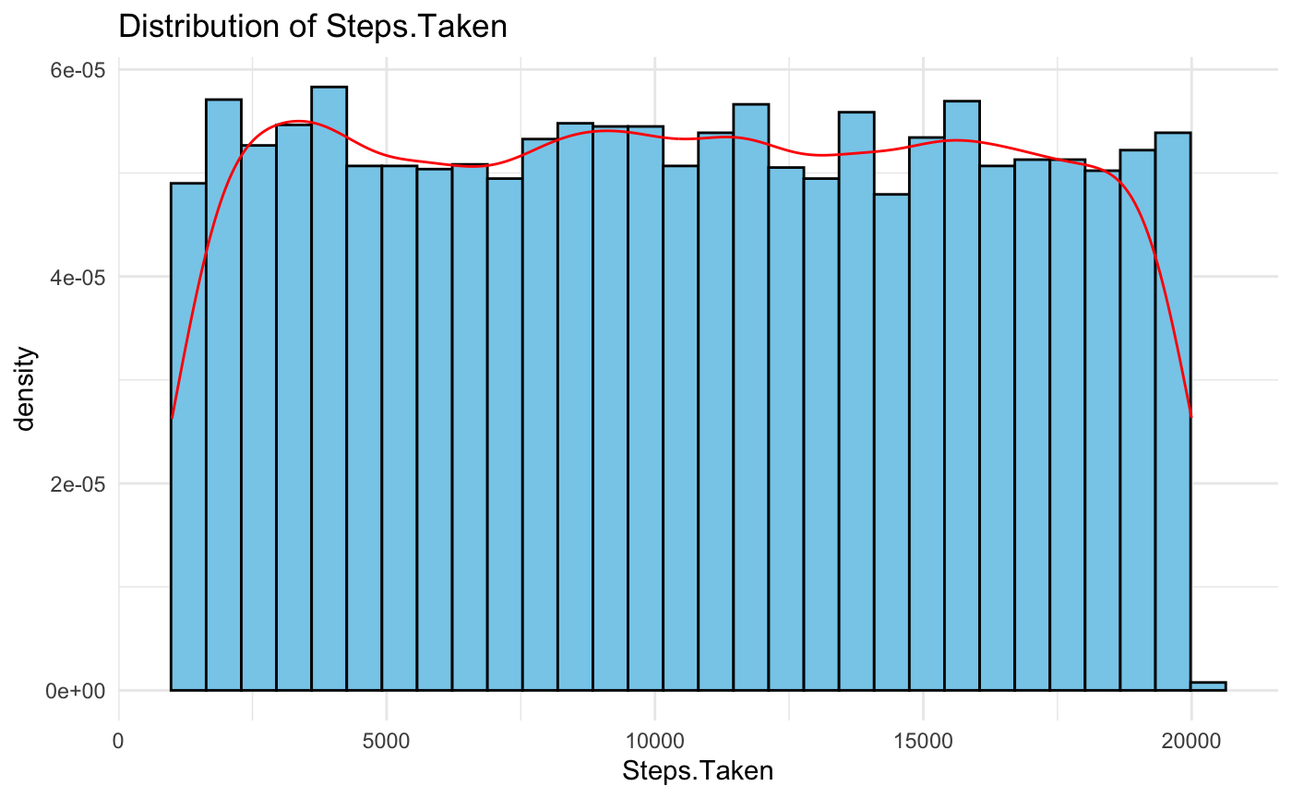
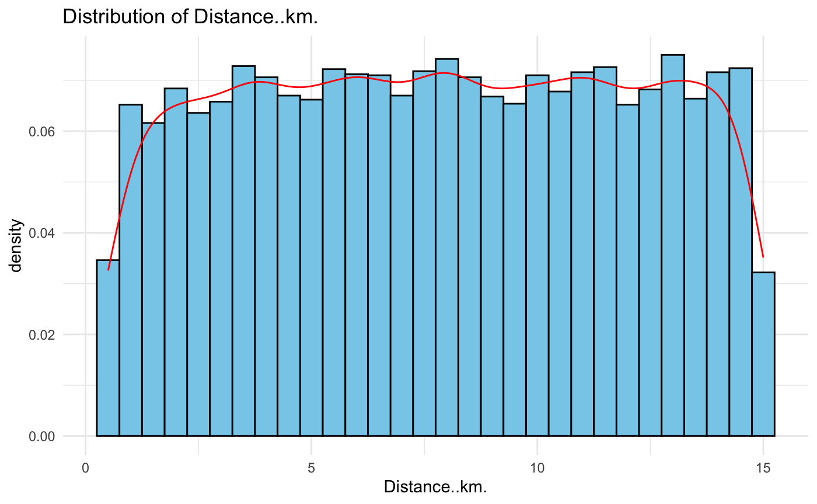
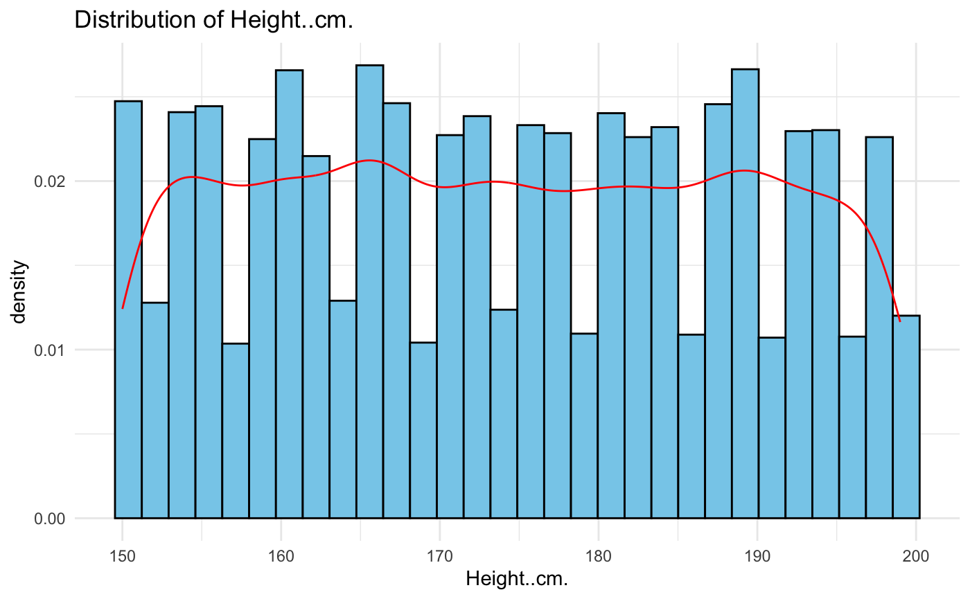
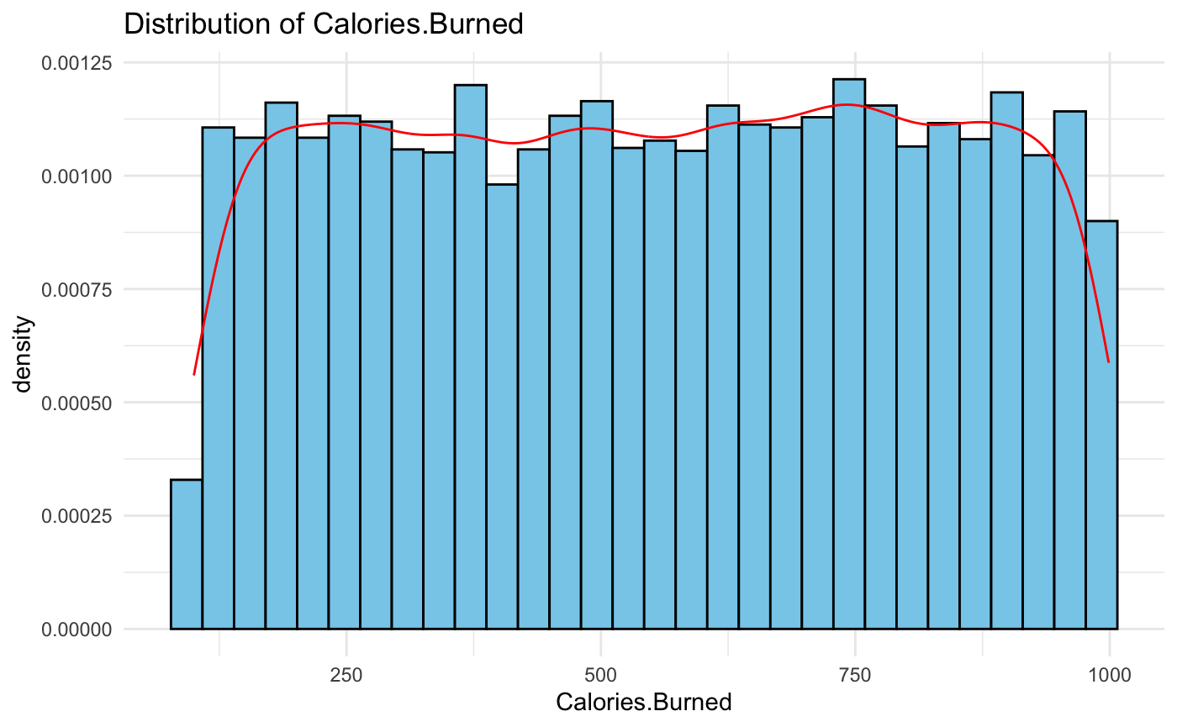
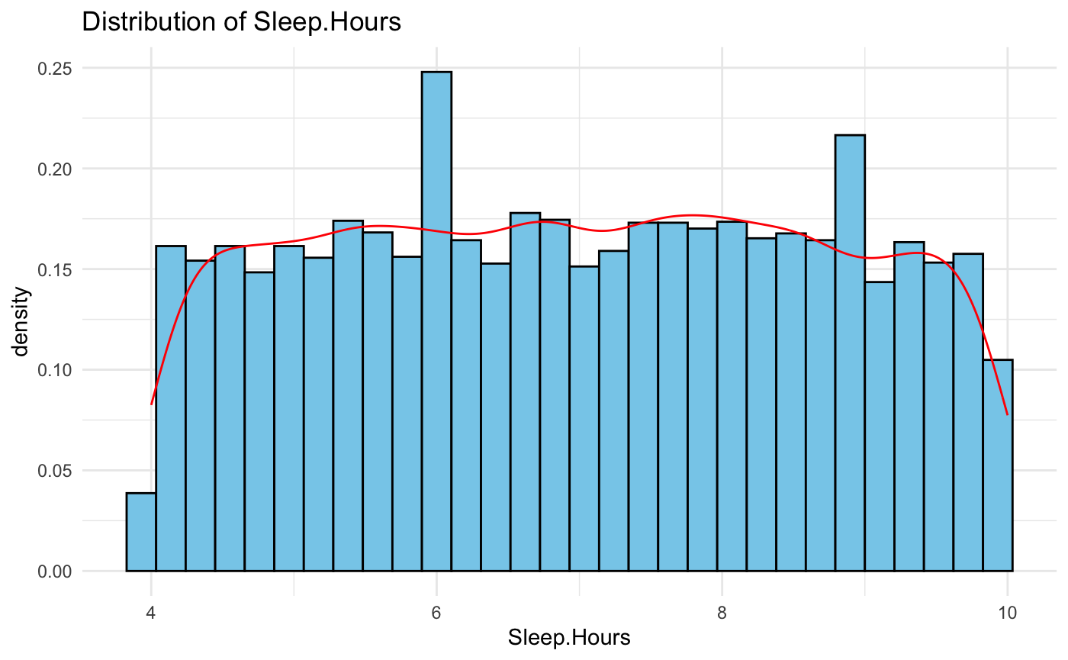
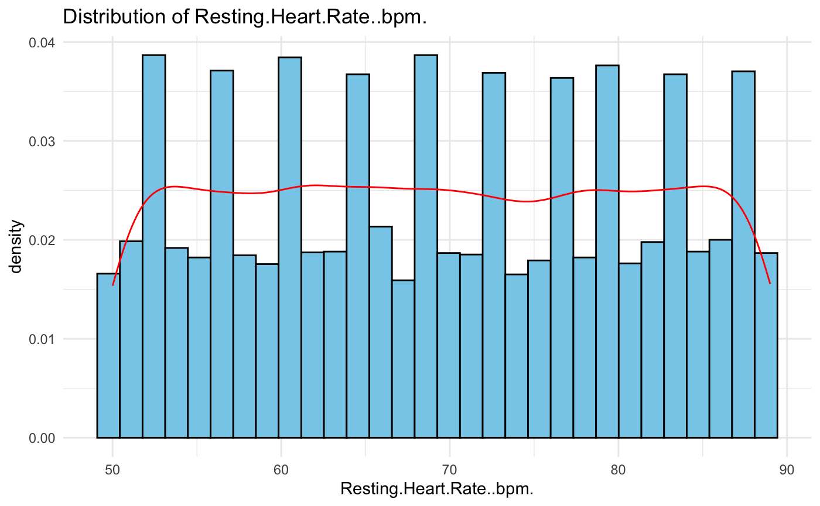
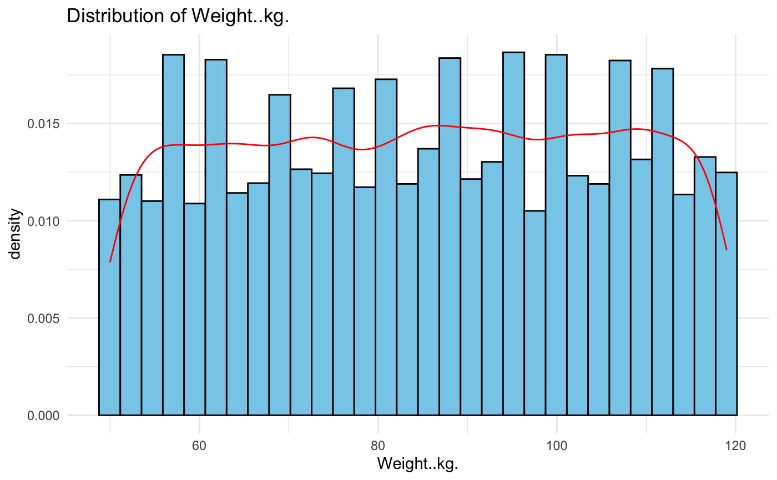
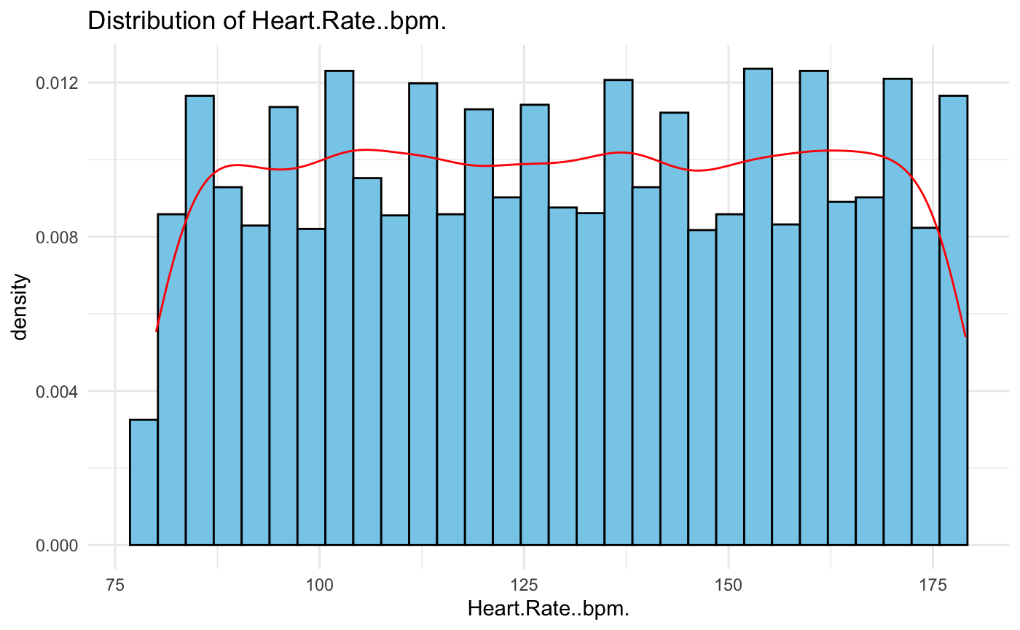
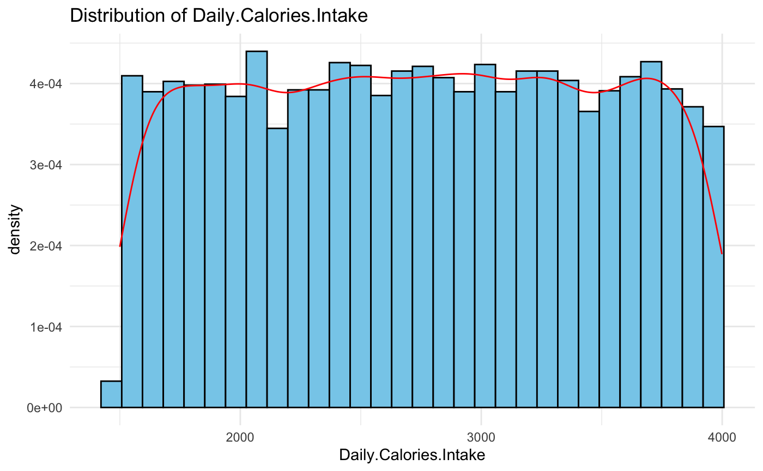
Variable distributions
appear to be uniform

Slide 15
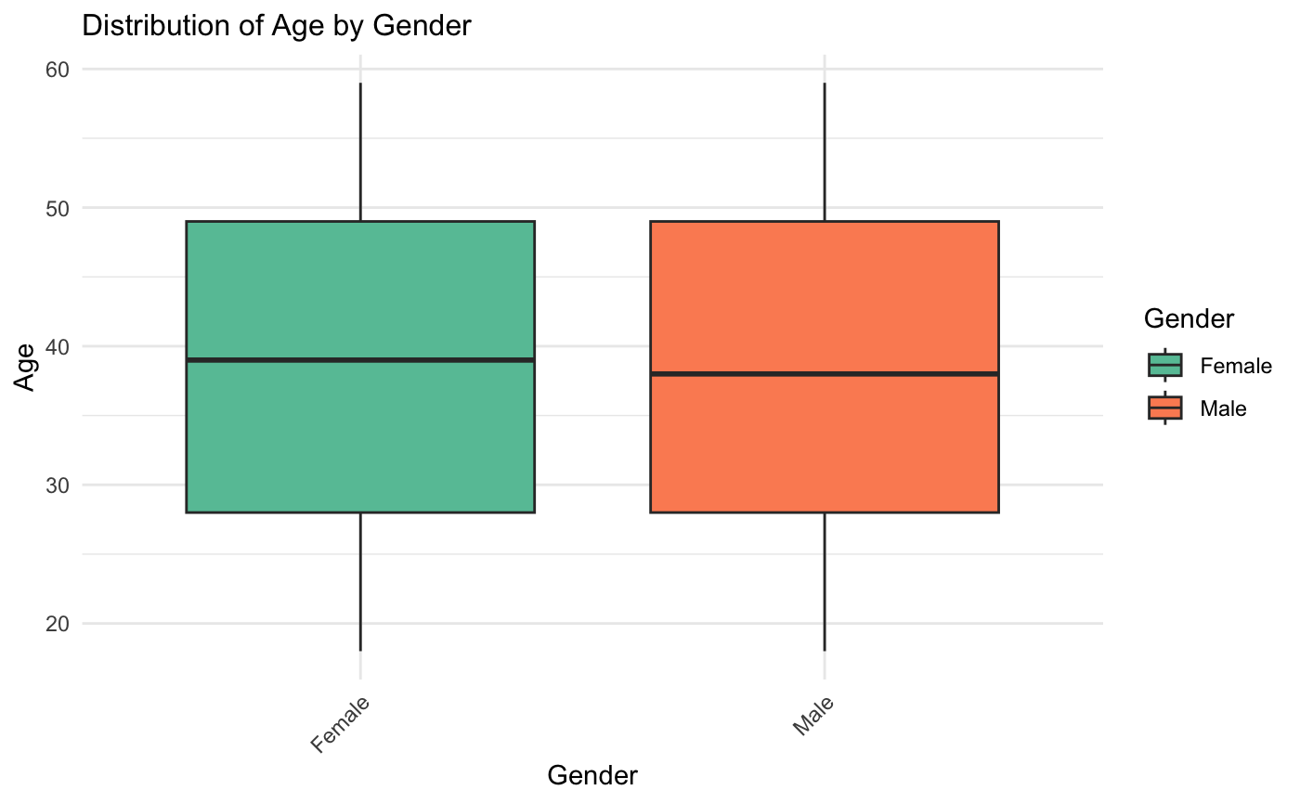
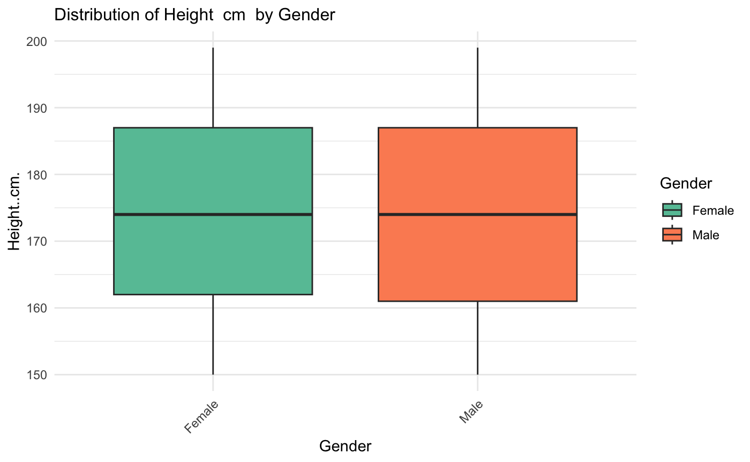
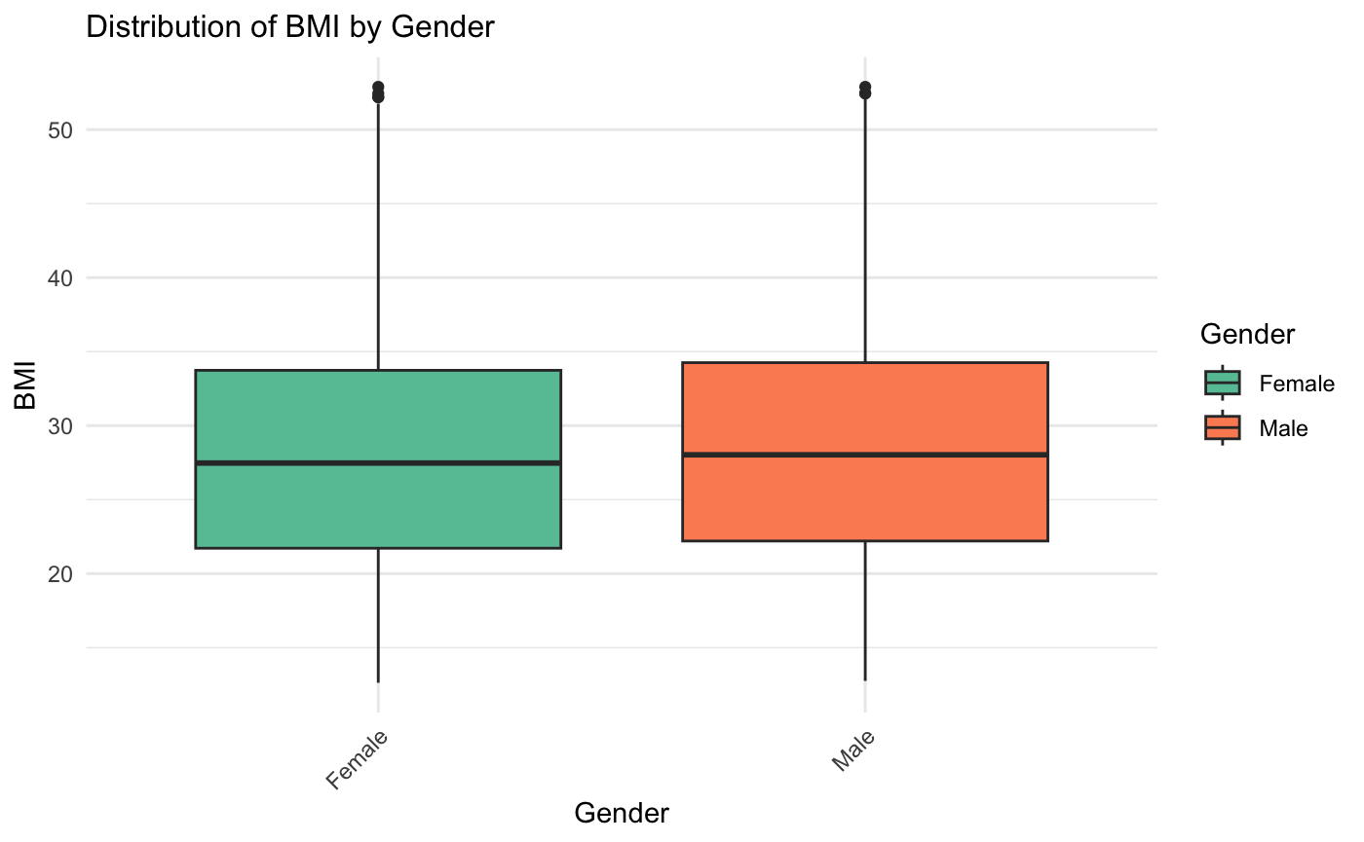
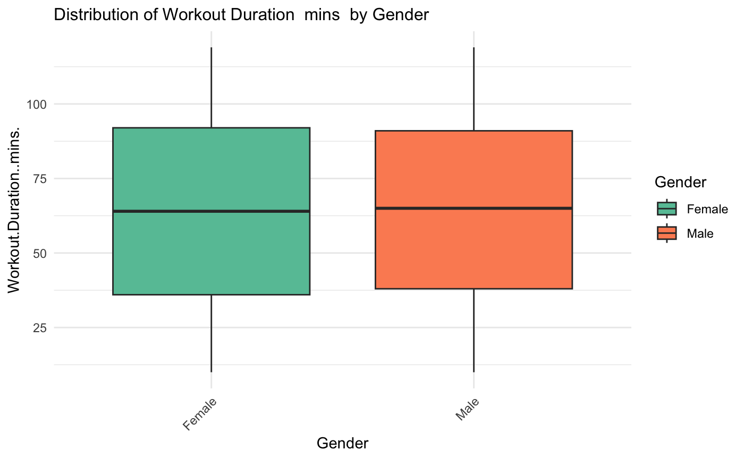
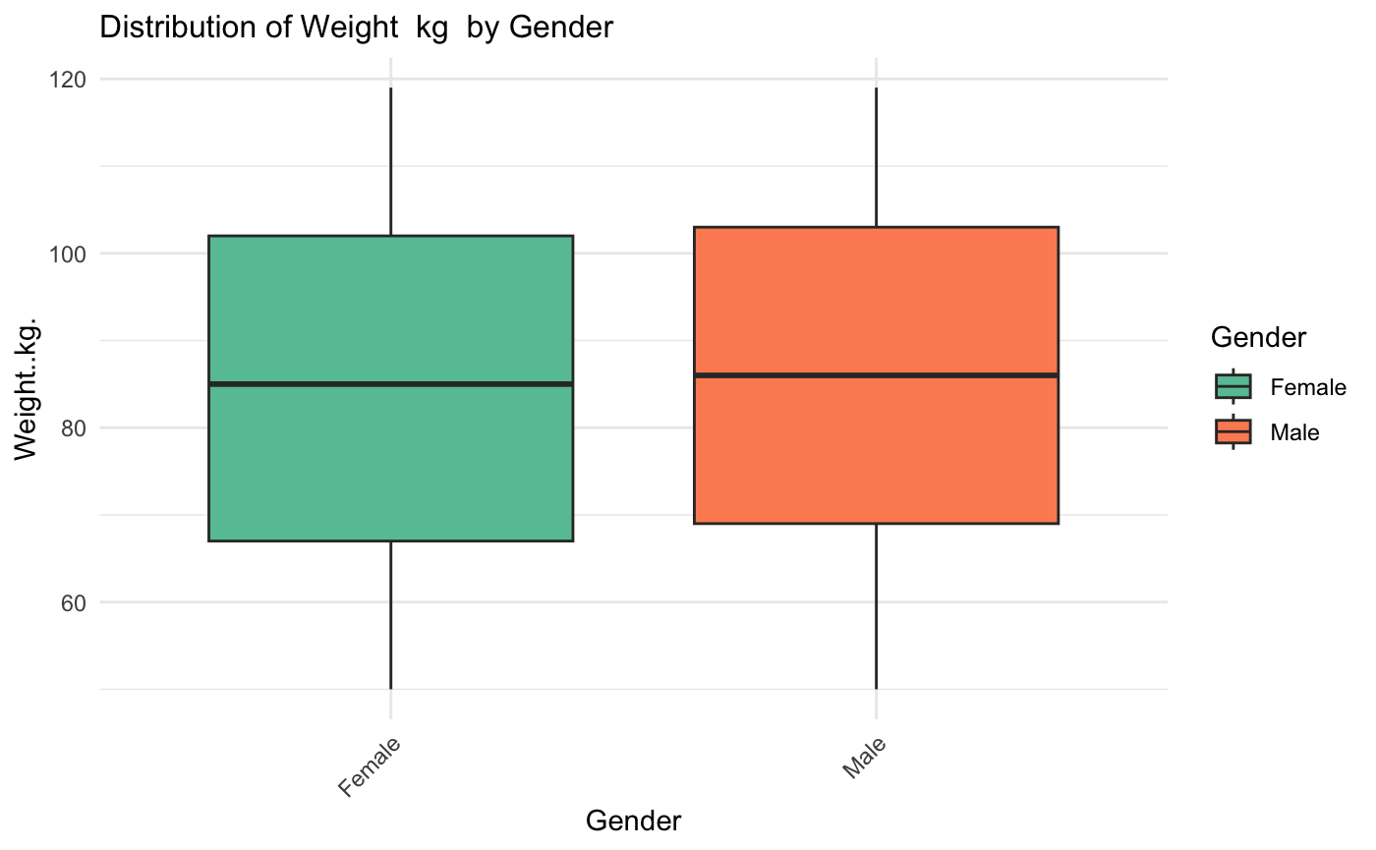
Mean difference between Genders t-tests
Variable | P values
________________________
height | 0.7979
weight | 0.0151*
duration | 0.8993
calories_burnt | 0.08177
heart_rate | 0.3567
steps | 0.717
distance | 0.9758
sleep_hours | 0.5938
daily_calories | 0.3998
resting_heart | 0.3748
Setbacks

Slide 16
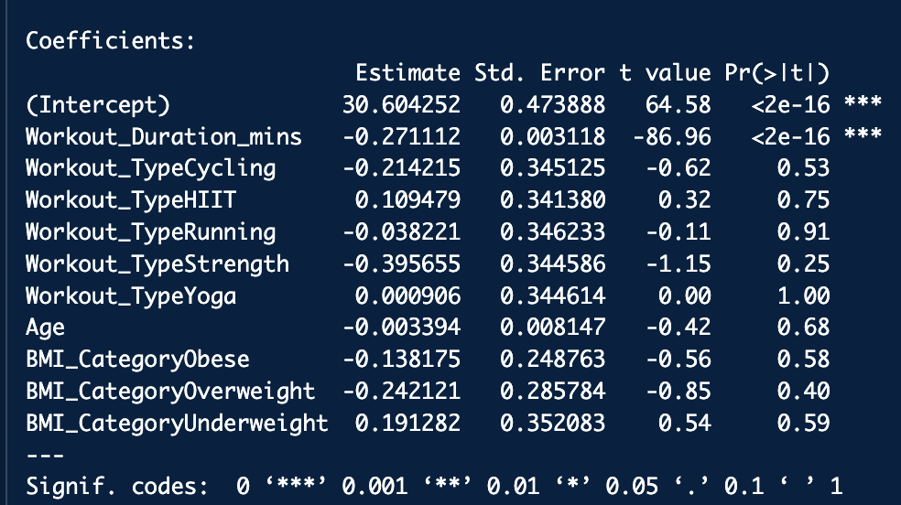
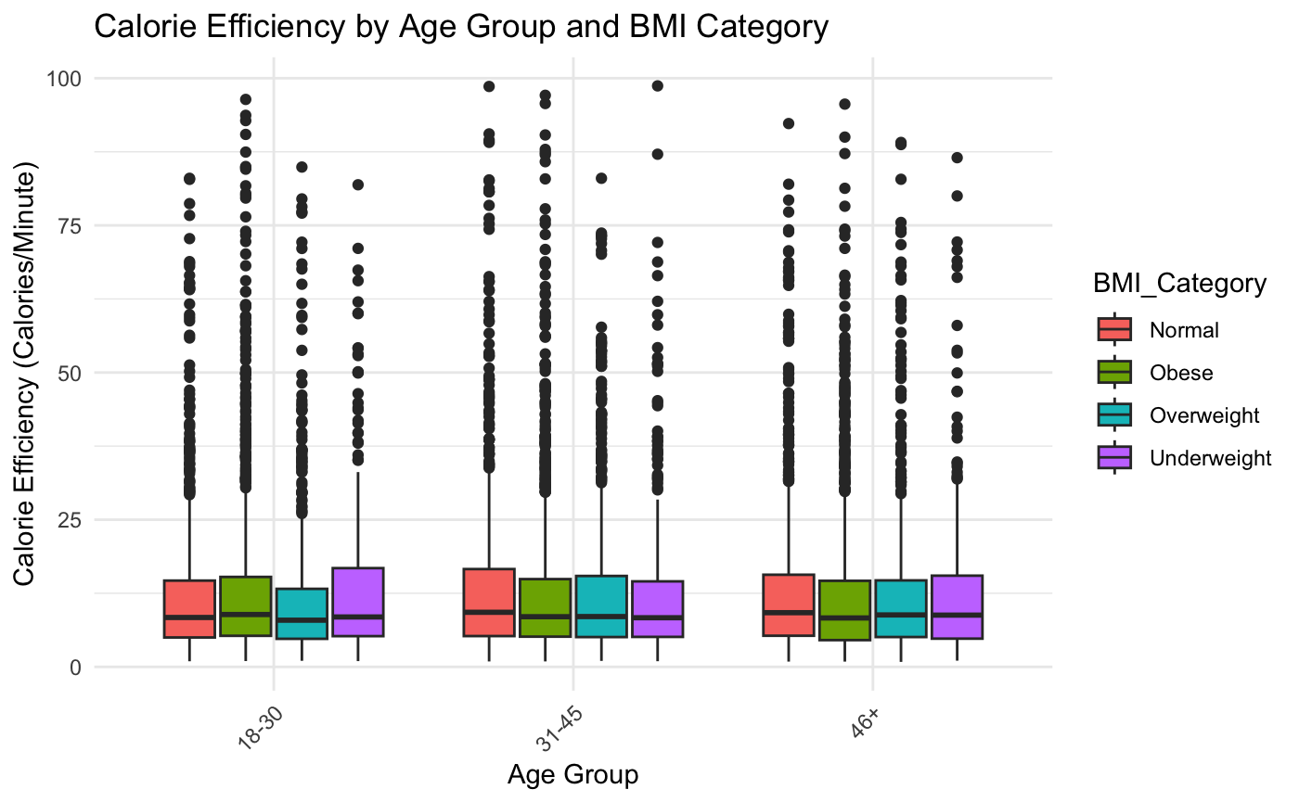
What combination of workout types and durations maximizes calorie burn efficiency for different user profiles (clustered by age, BMI, and fitness level)?
SMART Question 1

Slide 17
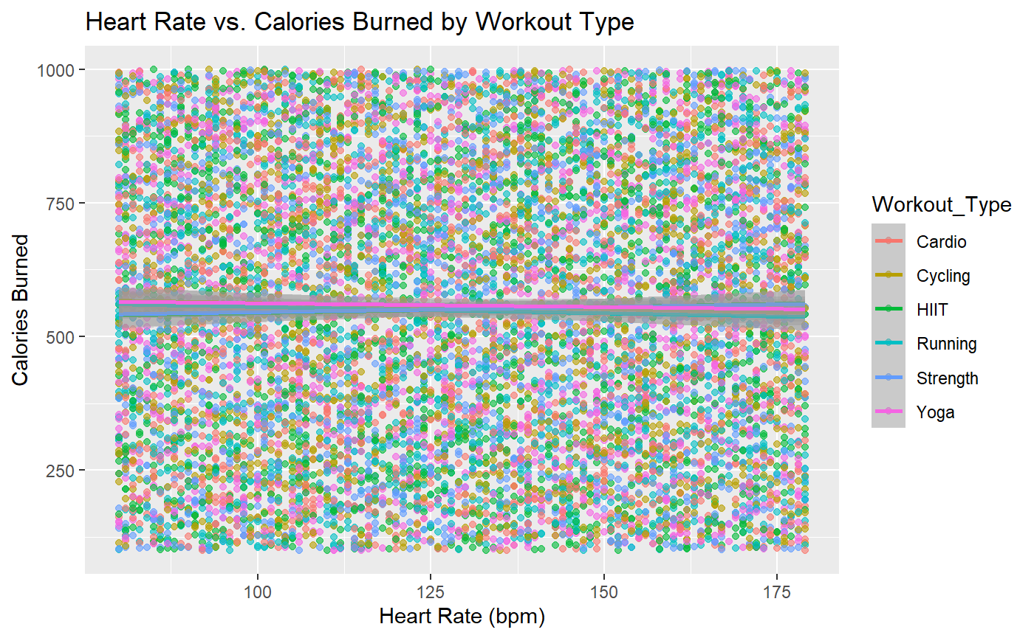
How does the relationship between heart rate patterns and calorie burn vary across different workout types, and can this predict optimal workout intensity?
SMART Question 2
Linear regression model:
Dependant variable (x) : Calories Burned
Independent variables (y): Heart rate and Workout Intensity
Separate model for each workout type

Slide 18
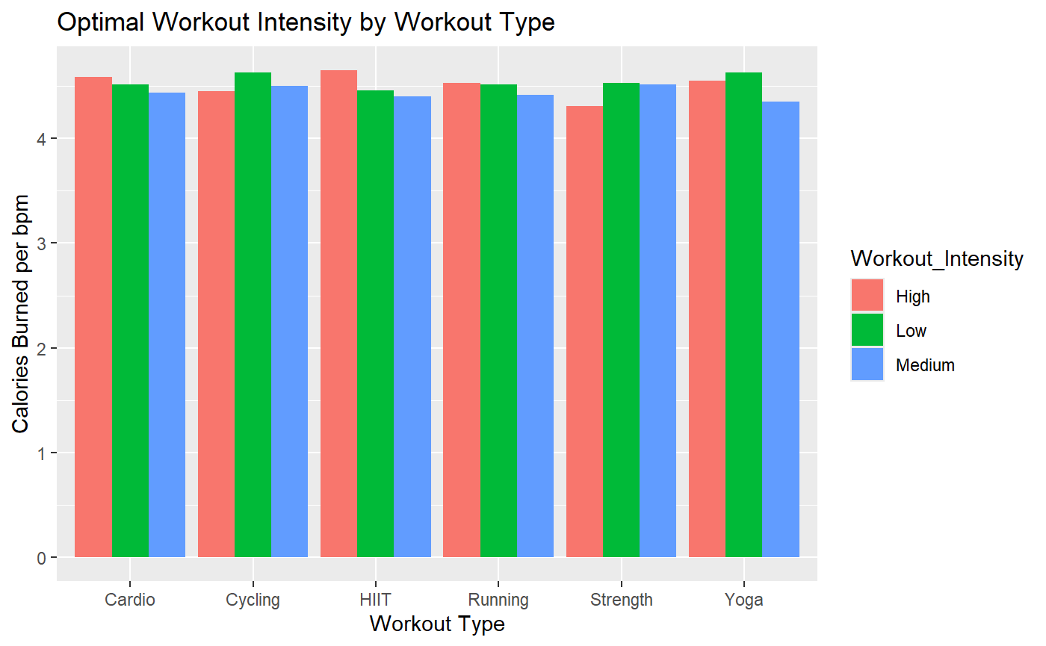
SMART Question 2
Linear regression results
Workout_Type | R_squared
Cycling | 0.0012
Cardio | 0.0026
HIIT | 0.0019
Strength | 0.0023
Yoga | 0.0021
Running | 0.0011
Conclusion: No significant effect on workout intensity based on the heart rate and calories burned according to the dataset.

Slide 19
Can we identify distinct user profiles based on their workout patterns using clustering analysis on workout duration, calorie burn, and heart rate?
SMART Question 3
K-means clustering:
Clustering variables: Workout duration in mins, Calories burned and Heart rate
Clustering process:
Scale the data (important)
Determine optimal number of clusters by elbow and silhouette method
Set seed and run k-means clustering
Summarize each cluster’s characteristics

Slide 20
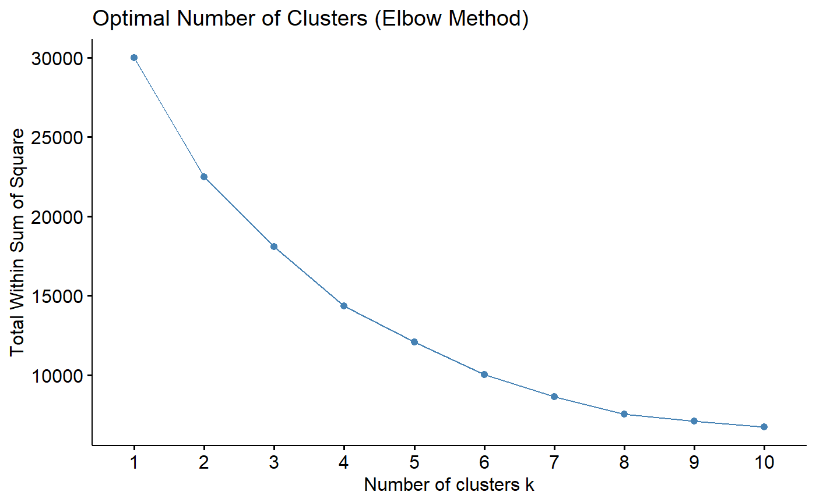
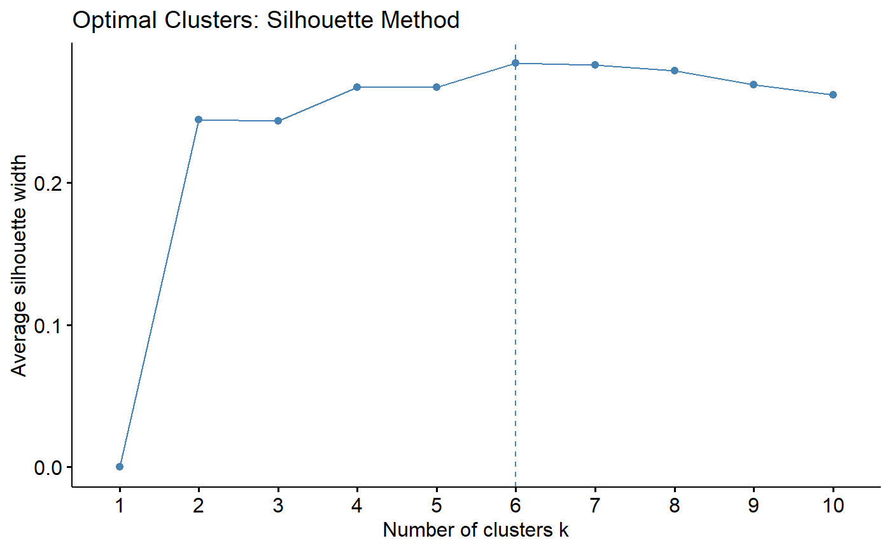
SMART Question 3
Determining the optimal number of clusters
Based on the elbow curve AND the silhouette score, we chose k = 6

Slide 21
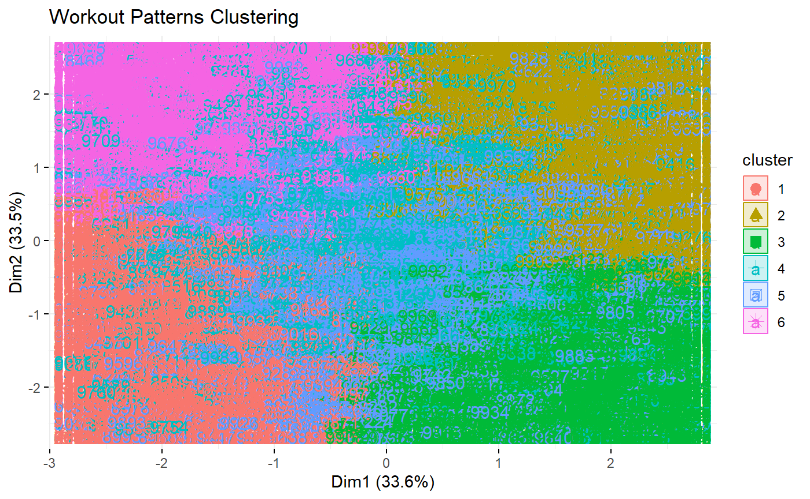
SMART Question 3
Cluster Summary
Cluster | Count | Avg_Workout_Duration | Avg_Calories_Burned | Avg_Heart_Rate
1 | 1664 | 72.56 | 292.66 | 157.92
2 | 1817 | 61.58 | 805.68 | 100.97
3 | 1683 | 33.35 | 718.77 | 153.06
4 | 1598 | 94.82 | 761.76 | 149.43
5 | 1660 | 33.64 | 341.49 | 111.7
6 | 1578 | 94.12 | 365.18 | 105.96

Slide 22
SMART Question 3
Results: Cluster characteristics
Cluster 1 (Moderate Duration, Low Calorie, High Intensity):
High intensity, cardio-focused workouts
Cluster 2 (Moderate Duration, High Calorie, Low Intensity):
Very high calorie burn
Low intensity, strength-focused or resistance workouts
Cluster 3 (Short Duration, High Calorie, High Intensity):
Short but intense workouts, possibly HIIT
Cluster 4 (Long Duration, High Calorie, High Intensity):
Extended cardio or endurance sessions
Cluster 5 (Short Duration, Low Calorie, Moderate Intensity):
Short duration, moderate effort, possibly low-intensity cardio or stretching
Cluster 6 (Long Duration, Moderate Calorie, Low Intensity):
Extended low-intensity workouts, e.g., walking or yoga

Slide 23
Is there an effect on calorie burn based on your workout type and BMI Category?
SMART Question 4
Factorial ANOVA [ More than two Factors]
Factor 1: BMI Category - Underweight, Normal, Overweight and Obese
Factor 2 : Workout Type - Cycling, Cardio, HIIT, Strength, Yoga, Running
Dependent Variable: Calories_Burned
Main Effects
BMI Category
H₀: μ_{underweight} = μ_{normal} = μ_{overweight} = μ_{obese}
2. Workout Type
H₀: μ_{cycling}= μ_{cardio} = μ_{HIIT} = μ_{Strengh}= μ_{yoga}= μ_{running}
Interaction effect
H₀: There is no interaction between BMI level and workout type on Calorie burn
H₁: There is no interaction between BMI level and workout type on Calorie burn

Slide 24
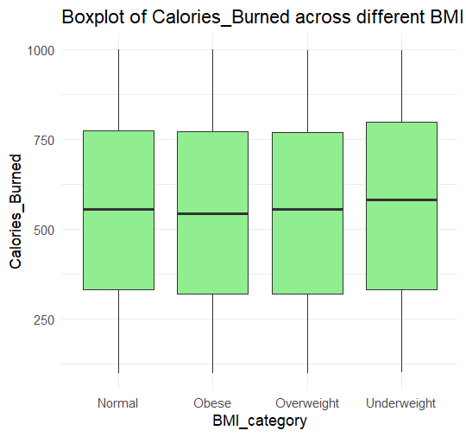
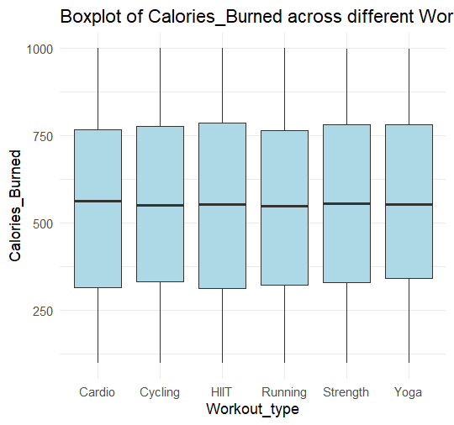
SMART Question 4
ANOVA Results
1. Main effects
- BMI Level: Cannot Reject HO as P value
is > 0.05
- Workout Type: Cannot Reject HO as P value is > 0.05
2. Interaction Effect
- Cannot Reject HO as P value is > 0.05

Slide 25
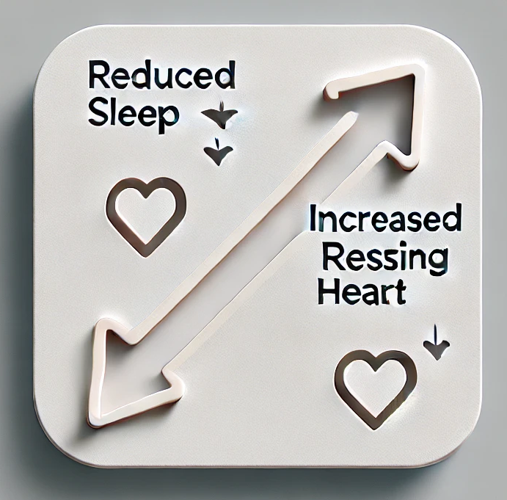
SMART Question 5
Is there a link between poor sleep and resting heart rate?
It is medically proven that fewer the hours of sleep and higher resting heart rate.
Correlation Test Results
Coefficient : -0.0125.
It is negatively correlated as expected, however the strength of the relationship is low.
Source: <https://pmc.ncbi.nlm.nih.gov/articles/PMC7680518/>

Slide 26
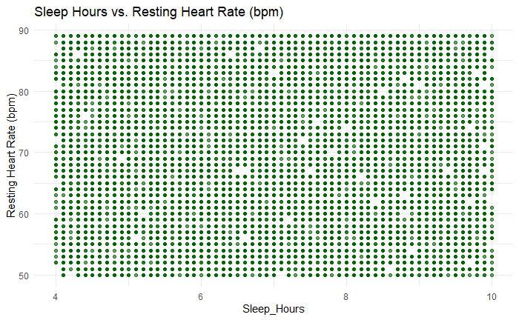

Slide 27

Is there a relationship between mood before and mood after workout?
SMART Question 6
Mood Before Workout: Happy, Neutral, Stressed and Tired.
Mood After Workout: Energized, Fatigued and Neutral
Using a Chi-squared test of Independence.
H₀: There is no relationship between mood before and after workout
H₁:There is a relationship between mood before and after workout
Contingency table
Test Results
P -value: 0.1253
P-value is > 0.05, Therefore we cannot reject the Null. There's no relationship between mood before and after workout.
 | Energized | Fatigued | Neutral
Happy | 817 | 886 | 808
Neutral | 831 | 807 | 873
Stressed | 832 | 802 | 791
Tired | 843 | 826 | 884

Slide 28
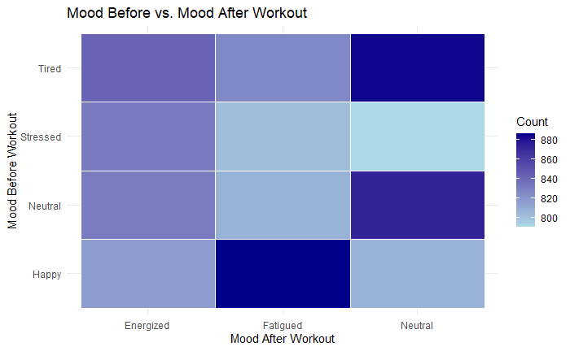

Slide 29
Setbacks
Dataset Analysis & Observations
Simulated Data: After extensive Exploratory Data Analysis (EDA), strong indications suggest that the dataset is artificially generated rather than real-world collected.
Lack of Correlation: Key workout metrics show minimal or no meaningful relationships, reducing the dataset’s predictive value.
Implications: Insights derived from this dataset may not generalize to real-world workout patterns, limiting its applicability for data-driven decision-making.
Next Steps: Consider alternative datasets with verifiable sources to ensure meaningful analysis and actionable insights.

Slide 30
Since our dataset appears artificially generated, future analysis should rely on verified fitness trackers, gym logs, or large-scale health studies.
Partnering with fitness apps or public health organizations (or exploring their websites for data) could provide real user data for more accurate insights.
Ensure Diverse & Standardized Data – A mix of demographics and consistent metrics will improve applicability and reliability.
Despite data flaws, analyzing workout habits reinforces the importance of physical activity.
Identifying artificial data prevents misleading conclusions in future research.
This analysis highlights the need for real data, pushing for stronger, evidence-based fitness insights.
Conclusions and Looking Forward →

Slide 31
References
https://www.cdc.gov/nchs/products/databriefs/db508.htm#:~:text=The%20prevalence%20of%20severe%20obesity%20in%20adults%20was%209.4%25%20and,from%207.7%25%20to%209.7%25.
The Lancet: Without immediate action nearly 260 million people in the USA predicted to have overweight or obesity by 2050

